Slide 1
Comparative analysis of a variety of machine learning tools on single cell transcriptomics
Llan, Almendariz Garcia (1419951)

Slide 2

Index
Introduction to dataset
Research aims
Week 1
Week 2
Week 3
Discussion & conclusion

Slide 3
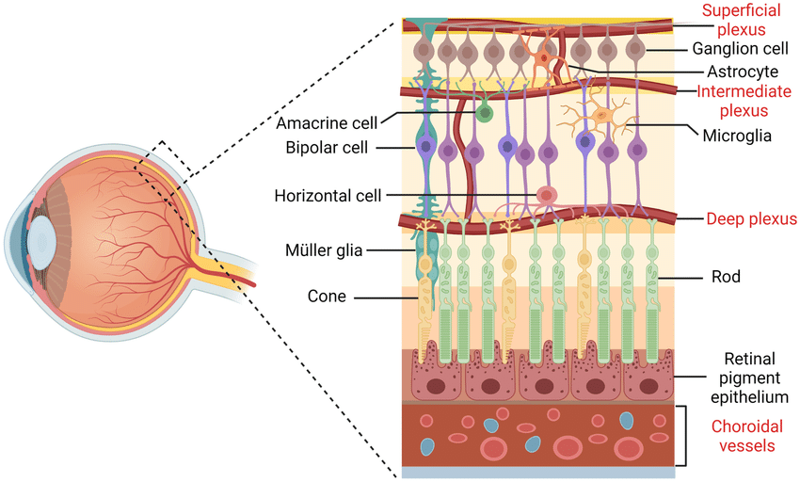
Neuronal
ScRNAseq Dataset
3724 x 452
Cone (color)
Bipolar OFF (light OFF)
Bipolar ON (light ON)
Amacrine
Modulate signal
Rod (low light)

Slide 4
Research aims
Regression for the prediction of Calm1 and Malat1 expression
Classification for prediction of the cell classes
Optimal model selection
Unsupervised learning to identify underlying structure of the data
Feature selection

Slide 5
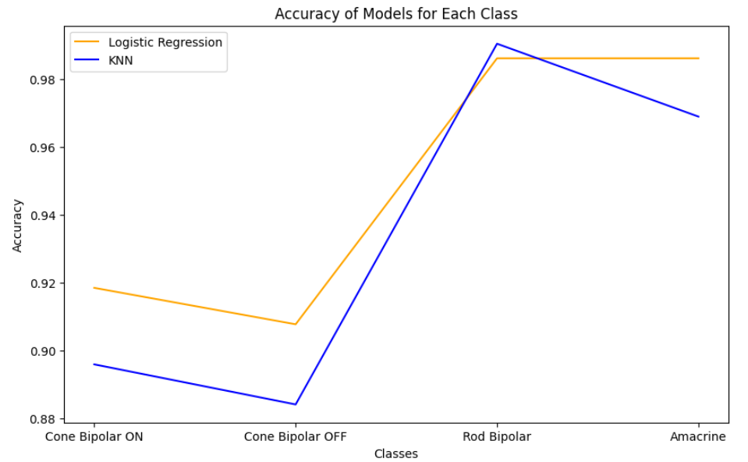
Week 1
Logistic Regression
Cross validated on test set

Slide 6
Week 2
SVM classifier
Linear kernel
One vs rest
K-fold cross-validation
K=5
 | Amacrine | Cone Bipolar OFF | Cone Bipolar ON | Rod Bipolar | accuracy
precision | 0.98 | 0.991 | 0.987 | 0.971 | 0.987
recall | 0.982 | 0.992 | 0.985 | 0.98 | 0.987
f1-score | 0.98 | 0.991 | 0.986 | 0.975 | 0.987
support | 25.8 | 331.6 | 287.4 | 100 | 0.987

Slide 7
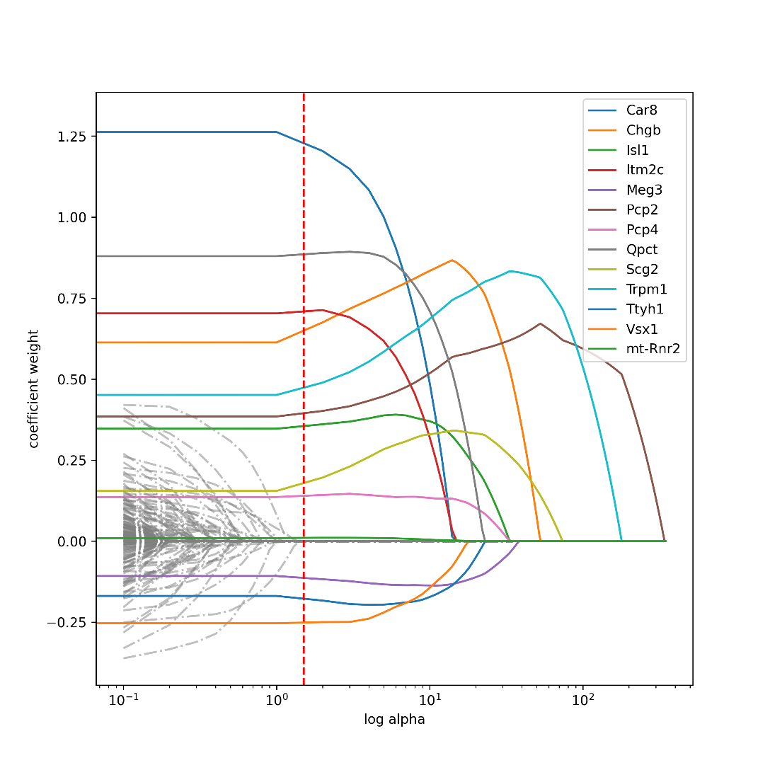
Week 2
Lasso regression for prediction of Calm1
K-fold cross-validation
k=5
Mean MSE = ~35

Slide 8
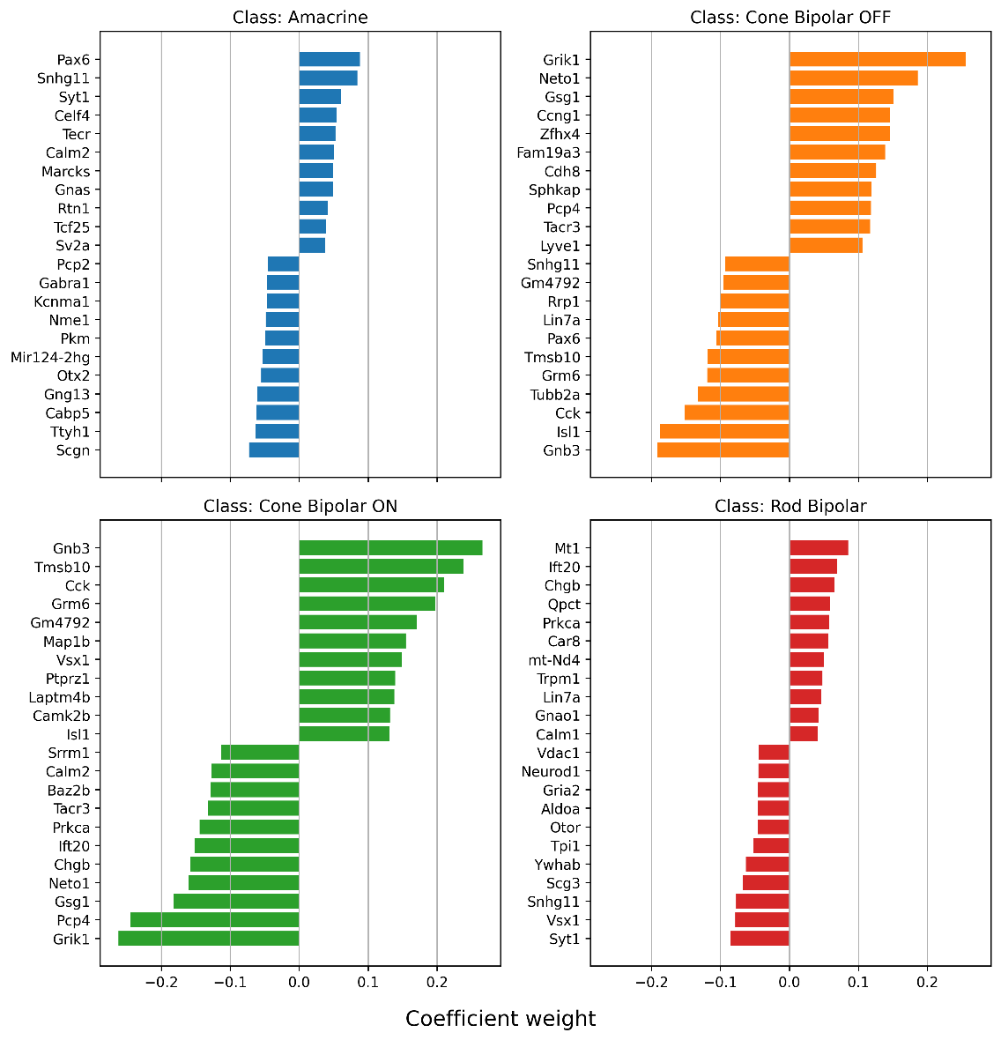
Week 2
SVM classification
4 decision functions
20 important features

Slide 9

Week 2
“Cone Bipolar ON” DAVID
Positive features
Enrichment for “synapse”, “neuronal cell body”, “axonogenesis”, and “dendrite”

Slide 10
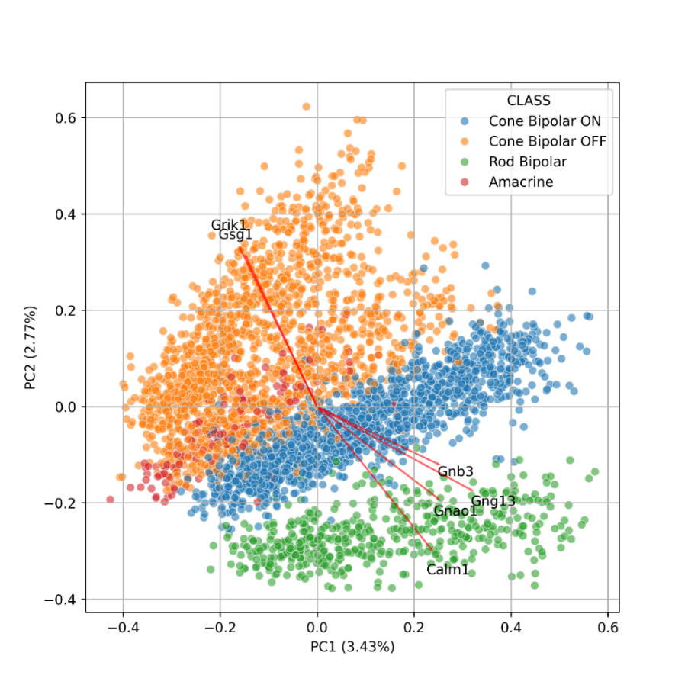
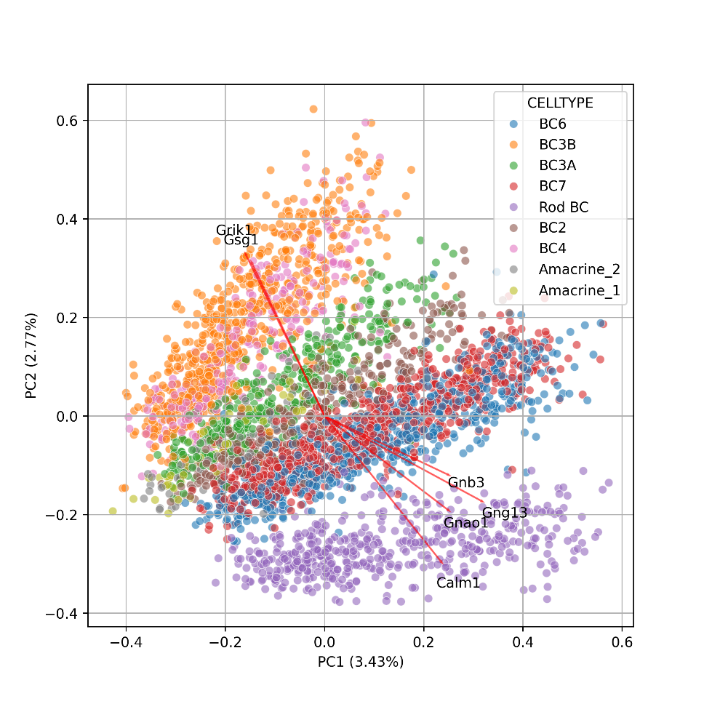
Week 3

Slide 11
Week 3
SVM classifier12 Pcs
Radial basis function
improved metrics
Sublise 3
K-fold cross-validation
K=5
 | Amacrine | Cone Bipolar OFF | Cone Bipolar ON | Rod Bipolar | accuracy
precision | 0.015 | 0.003 | 0.004 | 0.015 | 0.004
recall | -0.016 | 0.002 | 0.005 | 0.013 | 0.004
f1-score | 0 | 0.002 | 0.005 | 0.014 | 0.004

Slide 12
Discussion & conclusion
Calm1 expression could be predicted with a margin of error of 8 counts
Classification was possible with high accuracy
Optimal models:
Calm1 prediction: random forest (MSE=24)
Calm1 inference: Lasso
Class prediction: reduced SVM classifier
Classifier inference: full SVM classifier
PCA was able to separate classes in low dimension
Overlap between model features was found

